Slide 1
Task SCHEDULING IN CLOUD COMPUTING
CSCE 678 PROJECT
DARAKSHAN ANWAR - UIN:
RISHABH GARG - UIN: 130004847

Slide 2
TASK SCHEDULING - A NP-HARD PROBLEM
All over the years, task scheduling has been a major research area. Task scheduling is a NP-Hard Problem. A system’s performance can be significantly impacted by the efficiency of the task scheduling algorithm. The design and efficiency of these algorithms vary in different architectures and environments starting from single processor, passing by multiprocessor and ending with cloud computing. In cloud computing, one of the aspects of task scheduling is the allocation of tasks to different virtual machines. To give an analogy, task scheduling in case of cloud computing is same as multitasking, that is when several programs are being concurrently run on a computer.
Task scheduling is a NP-Hard problem. There are a lot of heuristic methods available for solving this, however none of them would be considered optimal. These strategies are said to be near-optimal which take less than polynomial time to provide an approximate-optimal solution. The idea is to search a near-optimal path in the search-space when there are several paths available and ignore the other paths to schedule the task. Task Scheduling is a simplified conversion from Knapsack problem which is a NP-Hard Problem.

Slide 3
Heuristic solvers TYpes
CLUSTER SCHEDULING
It refers to using as much processors as possible for the sub-tasks to increase the effectiveness of the make-span of the schedule generated. Here multiple processors can be connected to the shared main memory via a bus.
For e.g.: H. Cheng, “A high efficient task scheduling algorithm based on heterogeneous multi-core processor,” in Database Tech-nology and Applications (DBTA), 2010 2nd International Workshop on, Nov. 2010, pp. 1–4.
LIST SCHEDULING
It consists of 2 phases. In the first phase subtasks are given a priority and put in a list containing all the tasks. In the second phase, the subtasks are assigned to different processors when the processors are available to serve.

Slide 4
TASK SCHEDULING TYPES
STATIC TASK SCHEDULING
In case of static task scheduling, we already have information about time taken for tasks to execute and the Computer resources we have. So, we map which tasks are to be run on which system depending on the static information we already have.
DYNAMIC TASK SCHEDULING
In case of dynamic task scheduling, besides depending on the task execution times, also depend on the current state of the computers we have. This includes the current cpu state, memory state, etc. So the tasks are mapped to the computers depending on these factors which dynamically change and affect the scheduling of the tasks.

Slide 5
TASK SCHEDULING ALGORITHMS
Genetic Algorithm
Greedy Algorithm
Priority-based Job Scheduling Algorithm
Round Robin
Min-Min Algorithm
Particle Swarm Optimization (PSO)
First Come First Serve Algorithm

Slide 6
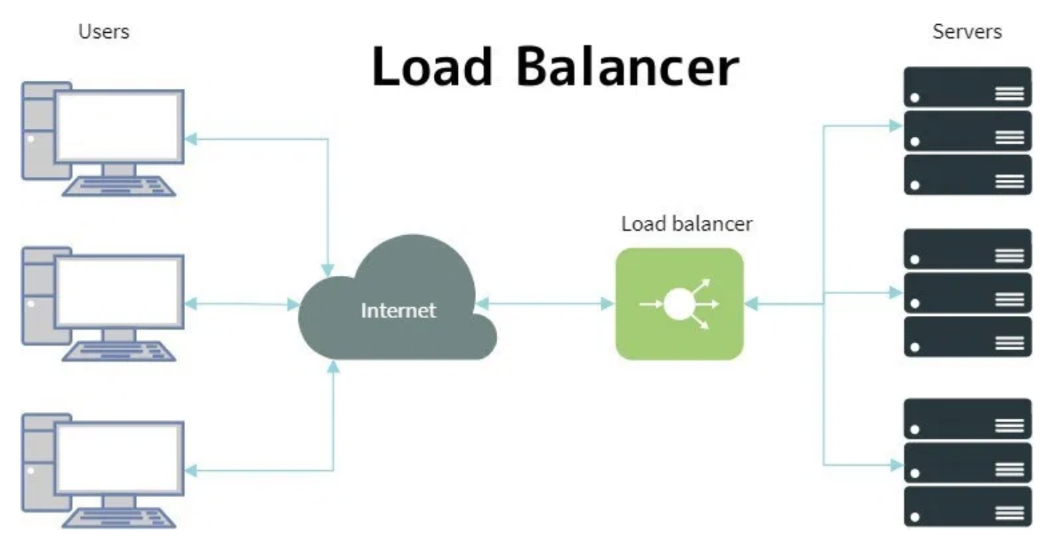
SYSTEM ARCHITECTURE

Slide 7
TECHNICAL DETAILS
We developed a Java based system for implementation of the load balancer algorithms.
We used docker containers for running the tasks.
Each time a request comes from the client, the load balancer selects a docker container based on the algorithm and forwards the request to that container.
The container processes the request and sends the response back to the load balancer server.
The load balancer submits the Http Response to the client.
The load balancer also makes sure, multiple users responses do not interfere with each other, basically each request executes on a separate thread.

Slide 8
SCHEDULER STRATEGIES
Round-Robin Task Scheduling
We initially created a simple round robin task scheduler to learn the various aspects involved in implementing a task scheduler. In this strategy tasks are allotted to the resources in a simple circular queue manner without realizing the impact of other factors involved.
Number of Pending Tasks per Container based Task Scheduling
In this method we created a map for each of the resources involved which create track of the pending tasks allotted to the resource. When a new task comes, the task is allocated to the resource with minimum number of pending tasks. This is based on the idea that resources which have better configuration would be able to process more tasks and would have less keys in their map relative to the resources which have lower configuration which would have more objects in their map.

Slide 9
SCHEDULAR STRATEGIES
Minimum API Execution Time based Task Scheduling
In this approach, we considered task’s execution time per resource. Every time a task is executed on a particular resource, we collect the execution time and calculate a running average for each task-resource pair. This value is used to schedule task in future. Idea is to schedule a task to a resource which is known to take minimum execution time for that specific task.
API Execution Time with Resource’s CPU and Memory Utilization Statistics
In this approach, we aimed to consider the CPU and memory utilization of each resource apart from execution time while scheduling the task. . Using a scheduler-based approach, our load balancer keeps track of CPU utilization and memory utilization of all the resources. The idea is to allocate a task to the CPU which takes minimum time to execute it(if it has executed it before) while keeping into account that it should have enough resources available.

Slide 10
ERROR HANDLING FEATURE
We have implemented an error handling feature which takes care of the situation when all the available resources are overload and cannot process any new task request.
In case our schedular finds out that all the available resources are overloaded, it schedules the task to a resource that takes minimum execution time. In case resource could not handle the request and sends an error response back to the scheduler, the scheduler adds this request in a separate queue meant to be processed after some time.
Scheduler processes each request in the queue one by one after a specific interval.

Slide 11
EXPERIMENT Strategies
For experimenting and testing our system, we used following variation in the system:
We used timer to simulate a condition where different request takes different execution time on each resources.
Cases:
We initially submitted 1000 task requests to the load balancer without overloading any of the container.
Afterwards, we overloaded few resources to see if schedular makes use of available CPU and memory utilization information. We also tested our error handling feature in this setup.
We experimented in a setup with 2 Containers and 5 Containers.

Slide 12
RESULTS
Number of VMs = 2 Overloaded = False
1000 Tasks execution times (in seconds)
Trial | Round Robin Approach | Min Pending Tasks Approach | Min Task Execution Time Approach | Min Task Execution Time & Overload-Check Approach
1 | 13.85 | 4.02 | 2.55 | 5.76
2 | 5.75 | 3.87 | 2.21 | 5.78
3 | 4.73 | 3.77 | 2.29 | 6.09
4 | 3.49 | 3.69 | 3.09 | 4.87
5 | 4.09 | 6.56 | 3.05 | 5.34
6 | 7.95 | 3.72 | 6.61 | 5.03
7 | 3.77 | 3.67 | 3.33 | 4.64
8 | 3.42 | 3.6 | 3.11 | 4.91
9 | 3.55 | 3.65 | 3.0 | 4.81
10 | 5.52 | 3.65 | 3.46 | 5.31
 | Average = 5.61 | Average = 4.02 | Average = 3.27 | Average = 5.25

Slide 13
RESULTS
Number of VMs = 2 Overloaded = True
1000 Tasks execution times (in seconds)
Trial | Round Robin Approach | Min Pending Tasks Approach | Min Task Execution Time Approach | Min Task Execution Time & Overload-Check Approach
1 | 8.23 | 4.65 | 7.82 | 4.38
2 | 4.96 | 5.19 | 7.41 | 8.95
3 | 5.05 | 5.62 | 5.31 | 6.56
4 | 11.09 | 4.9 | 5.38 | 3.91
5 | 5.1 | 4.47 | 5.16 | 4.42
6 | 6.99 | 4.73 | 5.48 | 4.24
7 | 6.2 | 4.51 | 5.07 | 4.47
8 | 4.99 | 7.61 | 5.22 | 4.16
9 | 4.94 | 6.08 | 5.34 | 7.76
10 | 6.22 | 7.53 | 7.45 | 4.95
 | Average = 6.38 | Average = 5.53 | Average = 5.96 | Average = 5.38

Slide 14
RESULTS
Number of VMs = 5 Overloaded = False
1000 Tasks execution times (in seconds)
Trial | Round Robin Approach | Min Pending Tasks Approach | Min Task Execution Time Approach | Min Task Execution Time & Overload-Check Approach
1 | 8.45 | 4.10 | 5.08 | 5.26
2 | 4.83 | 7.99 | 4.44 | 7.75
3 | 5.55 | 5.10 | 4.6 | 5.59
4 | 4.9 | 4.01 | 5.23 | 4.49
5 | 5.3 | 3.96 | 4.8 | 4.64
6 | 4.91 | 4.33 | 4.89 | 4.35
7 | 6.08 | 4.11 | 5.43 | 5.29
8 | 5.12 | 3.95 | 5.62 | 4.38
9 | 4.97 | 3.96 | 4.23 | 4.24
10 | 4.68 | 4.00 | 4.81 | 3.96
 | Average = 5.53 | Average = 4.55 | Average = 4.19 | Average = 5.0

Slide 15
RESULTS
Number of VMs = 5 Overloaded = True
1000 Tasks execution times (in seconds)
Trial | Round Robin Approach | Min Pending Tasks Approach | Min Task Execution Time Approach | Min Task Execution Time & Overload-Check Approach
1 | 8.76 | 8.26 | 7.47 | 8.51
2 | 8.36 | 10.26 | 4.99 | 5.42
3 | 11.55 | 9.60 | 6.96 | 8.66
4 | 5.94 | 5.32 | 6.14 | 7.53
5 | 6.11 | 5.20 | 6.14 | 5.25
6 | 6.31 | 4.82 | 8.48 | 5.91
7 | 8.71 | 7.10 | 11.78 | 6.25
8 | 6.92 | 5.95 | 12.27 | 5.50
9 | 6.62 | 5.49 | 4.82 | 5.26
10 | 4.31 | 5.63 | 4.46 | 4.51
 | Average = 7.36 | Average = 6.76 | Average = 7.35 | Average = 6.28

Slide 16
RESULTS Ordering
Without Overloading
Min Task Execution Time Approach>Min Pending Tasks Approach>Min Task Execution Time & Overload-Check Approach>Round Robin Approach
With Overload
Min Task Execution Time & Overload-Check Approach > Min Pending Tasks Approach > Min Task Execution Time Approach >Round Robin Approac

Slide 17
FAILED APPROCHES AND LESSON LEARNT
Concurrency Modification Exception:
We were using a Collection for storing the execution time for each task-resource pair. Each time a task was executed we were updating the value.
Also, we were sorting this collection list each time we had a new request coming for scheduling.
This concurrent update and read created exception
Solution: changed the design so that we don’t need to sort the collection each time a new request comes.
Atomic Integer for selecting the container in round robin approach
Concurrency linked list for implementing the 'Error Handling Feature’.

Slide 18
LIMITATIONS AND FUTURE WORK
Limitations
Tuning: We need to tune resource utilization thresholds each time new tasks will come.
Failure Handling: If a container crashed due to overload, we need to create a process that would reboot the container. Same if the application inside the container crashed.
Future Work
Algorithm Improvement: We can used weighted approach for Min Queue Length approach, where weights can be given according to tasks execution times.
Scalability: We can use multiple Load balancers to decrease traffic on a single load balancer.
Scalability: If all the containers are overloaded, we can create a temporary container which would be turned off when not needed.

Slide 19
REFERENCES
A. Ahluwalia and V. Sharma, “A survey on task scheduling techniques in cloud computing,” 2016.
M. Moniruzzaman, K. Idrees, M. Rossbory, and J. Gracia, “An adaptive load-balancer for task-scheduling in fastflow,” 2015.
Raja Manish Singh, Sanchita Paul and Abhishek Kumar, “Task Scheduling in Cloud Computing: Review”

Slide 20




